Slide 1

Diabetes Readmission Prediction
Rayees Ahamed
Springboard Data Science Student (2021-2022)

Slide 2




The Problem
Diabetes is a chronic health disease caused due to excess glucose levels
From 1998 to 2008, US hospitals seen high number of diabetes patient’s readmitted within 30 days
“What are the factors leading to high readmission of diabetes patients to hospital within 30 days of discharge?”

Slide 3
Our Goals
Identifying important attributes that caused diabetes patients’ getting readmitted
Understanding the relationship between different attributes
Key medicines used in treatment that helped avoid hospital readmission
Building a prediction model to identify whether a patient will get readmitted or not

Slide 4
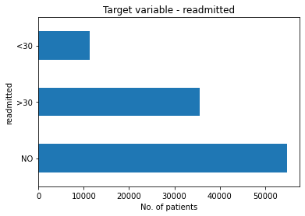
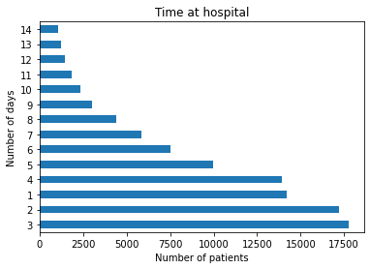
Data Exploration – Time at hospital
Distribution of readmitted patients
54% - did not get readmitted
35% - readmitted after 30 days
11% - readmitted within 30 days
Time spent at hospital by patients
On average each patient spent 4.5 days
72% - spent below 6 days
20% - spent above 6 days
Maximum stay – 14 days
Key questions to asked:
How large group of people did not get readmitted?
Why some patients alone staying longer time in hospital?

Slide 5
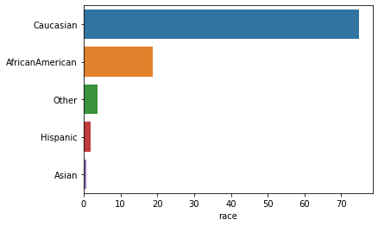
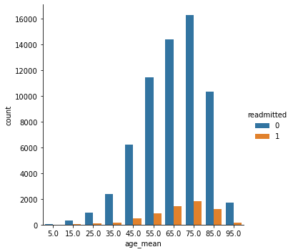
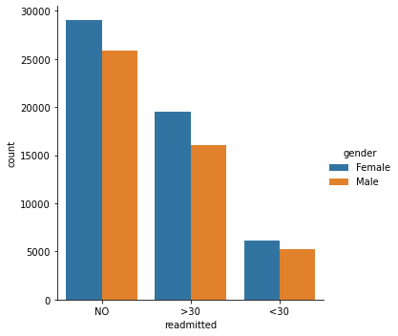
Data Exploration – Patient demographics
Patients from different races in this dataset
High number of patients are from Caucasian & African American races
Male and female had equal distribution in both readmitted & not readmitted group
Patients aging from 45 to 85 are more vulnerable to diabetes and 65 to 85 aged patients are riskier to get readmitted within 30 days
Age distribution of readmitted patients
Gender distribution

Slide 6
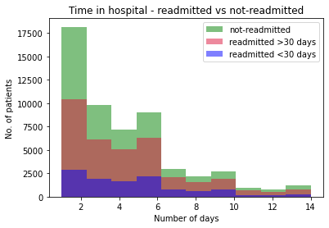
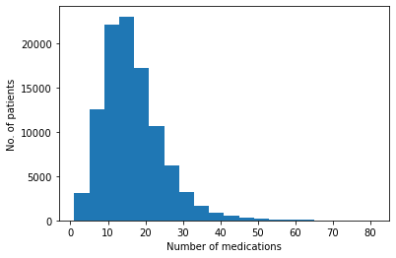
Data Exploration – Change of medications
Did patients are suggested to change medications?
60% - asked to change
40% - no change
Relative distribution of hospital time in readmitted patients
Number of medications taken by patients
Most patients taken from 2 to 40 medicines over the period
Average number of medications taken 16-17 medicines per patient.
Does change in medications help patients avoid readmission?
Can it reduce the time each patient spent at hospital?
What medicines specifically taken by patients who are not readmitted?

Slide 7
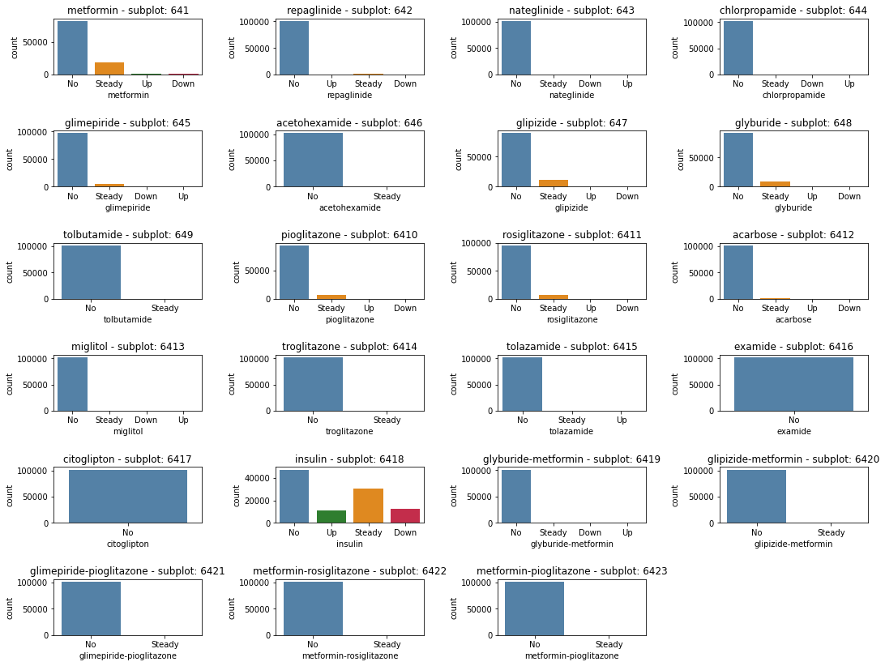
Distribution of medicines in readmitted patients
Selected medicines with significant change in their prescription levels:
Insulin
Metformin
Glimepiride
Glipizide
Glyburide
Pioglitazone
Rosiglitazone

Slide 8
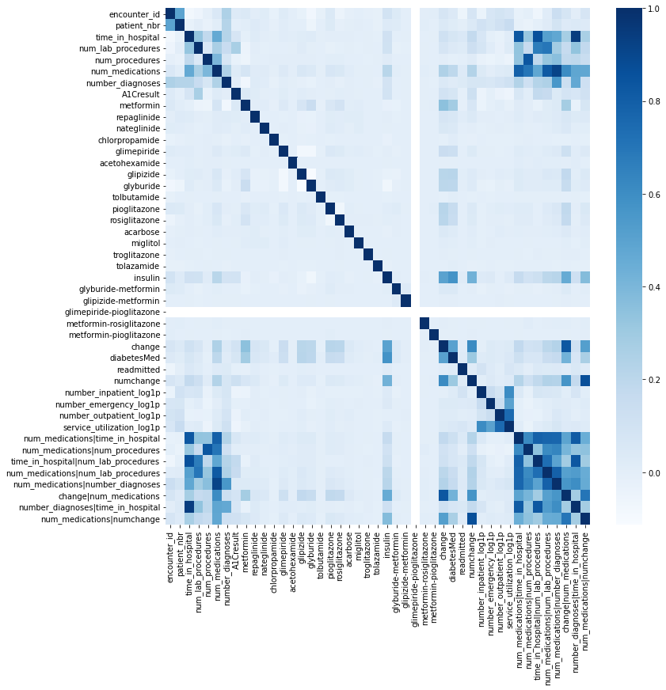
Feature Engineering
Interaction between variables and new features identified :
Number of medications | time in hospital
Number of medications | number of lab procedures
Number of diagnoses | number of medications
Age | number of diagnoses
Number of medications | change of medicines
Observations from heatmap:
Time in hospital & number of medications - positively correlated
Number of procedures & number of medications - positively correlated
Age & number of emergencies - negatively correlated
Correlation heatmap of all features

Slide 9
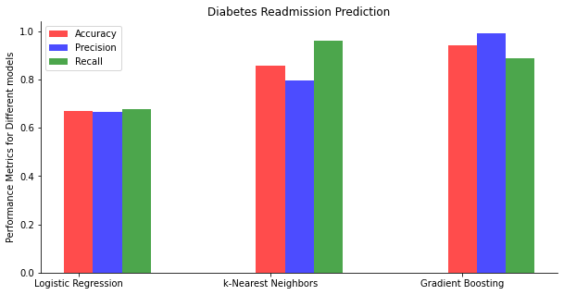
Building the prediction model
Comparison of performance metrics between models
Diabetes readmission classification
Yes No
Models
Logistic regression
K-Nearest Neighbors
Gradient boosting
Performance metrics
Gradient boosting classifier topped in accuracy and precision scores
Compared to k-NN classifier, it is faster and computationally less expensive.
We selected gradient boosting classifier as our best model
Hyperparameter tuning
Final model

Slide 10
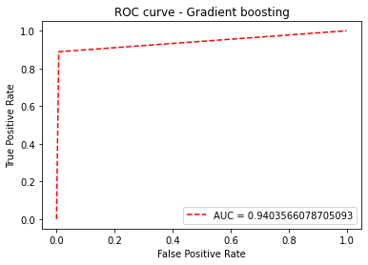
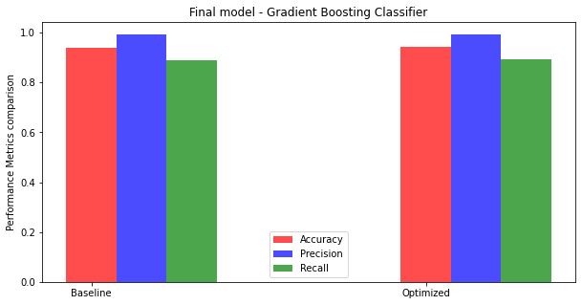
Final model evaluation
Hyperparameter tuning and best parameters:
Randomized Search CV
Learning rate: 1
Max depth: 2
Number of estimators: 400
Cross validation folds: 5
Tuned model ROC-AUC score: 0.94
Best Model: Gradient Boosting Classifier
Final model performance metrics:
Accuracy – 94%
Precision – 99%
Recall – 89%

Slide 11
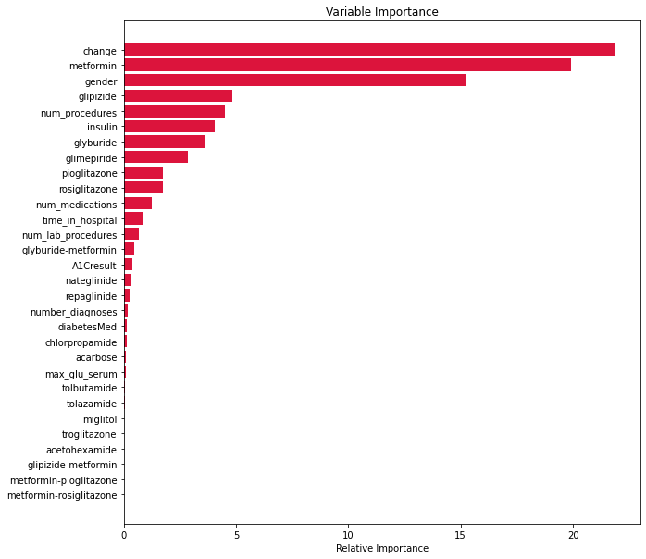
Features importance for this dataset
Most important features of this dataset:
Change in medications
Gender
Metformin
Glipizide
Insulin
Glyburide
Glimepiride

Slide 12
Summary
Gradient boosting classifier – best model for prediction diabetes patients' hospital readmission
Model performance scores were above 90% (i.e., Accuracy of 94%, precision of 99%)
Medicines played a significant role in predicting the right class of patients
Limitations:
Class imbalance of the dataset should be taken care prior to deployment
Prediction also listed gender as important feature, hence more data can be added to evaluate this fact
Weight column – an important feature had 97% missing values
Weight information of the patients can relate to their obesity and other disease status
Obesity linked diseases also may be a reason for their frequent readmission

Slide 13


Thank you
Acknowledgements

